Slide 1
CPPython: A Lexer + Parser System for simple Python programs
Debjit Dhar, Soham Lahiri, Sudipta Saha and Chirantan Nath
This work was done as a part of the Compiler Design Mini-Project for JU BCSE UG3 Code at CPPython (This project is licensed under the MIT License).

Slide 2
Problem Statement-Requirements
Python like language with the following supports-
Data Type: integer (int) and floating point (float), string (str), boolean (bool) and list (list)
Data type of a variable is determined at the time of assignment of a value to it.
Python “for” loops are supported which loop over strings and lists.
The following statements are supported: assignment statements and ‘print’ statements. The statements may have arithmetic expressions with operators ‘+’, ‘--‘, ‘*’, ‘/’.

Slide 3
Problem Statement-Workflow
Part I – Construct a CFG for this language.
Part II – Write a lexical analyser to scan the stream of characters from a program written in the above language and generate stream of tokens.
Part III – Maintain a symbol table with appropriate data structures.
Part IV – Write a bottom-up parser for this language (modules include Item-set construction, computation of FOLLOW, parsing table construction.

Slide 4
Introduction
🐍 Why Build a Compiler for Python?
🔧 Motivation
Interpreter Bottlenecks: The standard Python interpreter (CPython) executes line-by-line, introducing significant runtime overhead and slow performance for compute-heavy or performance-sensitive applications.
Bridging the Gap: A Python compiler transforms Python code into a lower-level representation (e.g., bytecode, C++, or machine code), aiming to:
💨 Boost performance via static analysis and optimization
🔐 Enhance security by hiding source code
🧱 Enable static error detection and better tooling support
📦 Improve portability and reduce deployment dependencies

Slide 5
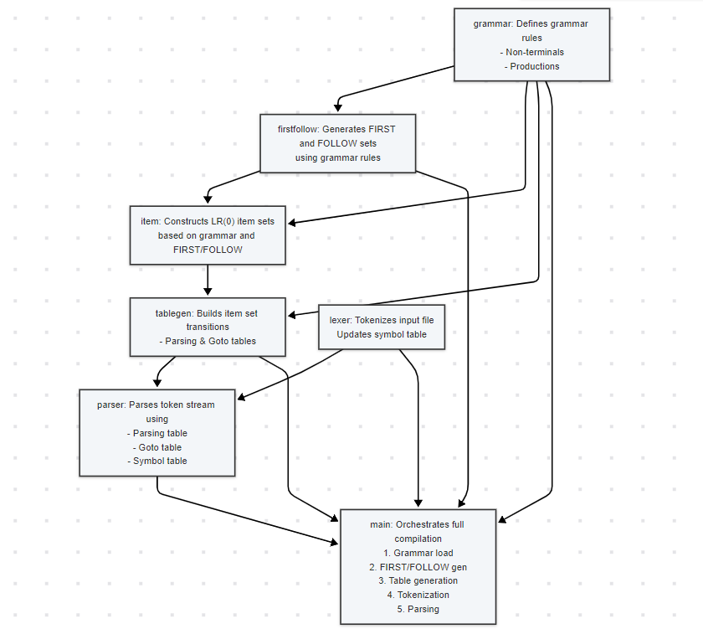
System Description

Slide 6
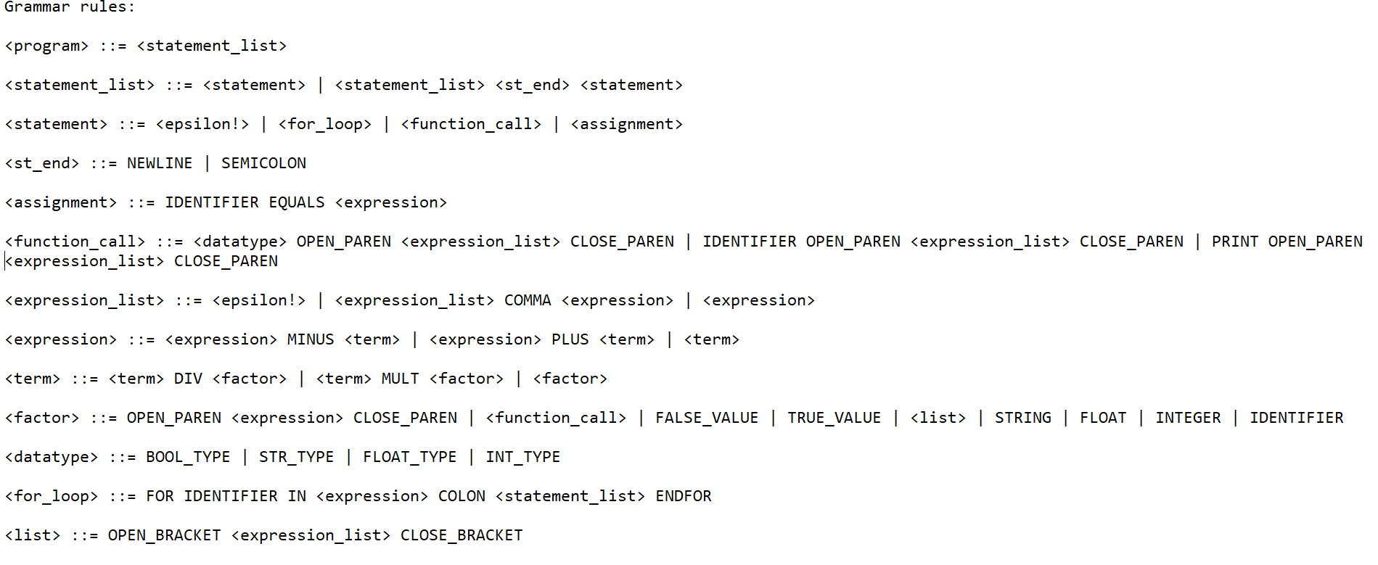
The CFG

Slide 7
CFG(contd)
Program Structure:
<program> is defined as a <statement_list>, meaning a program is a sequence of statements.
Statement List:
<statement_list> can be:
A single <statement>
A sequence of statements separated by a statement delimiter (<st_end>)
Statements:
<statement> may consist of:
An empty statement (<epsilon!>)
A for_loop
A function_call
An assignment
Statement Endings:
<st_end> represents the end of a statement, using NEWLINE or SEMICOLON.
Assignments:
<assignment> follows the pattern: IDENTIFIER EQUALS <expression>
Function Calls:
<function_call> has multiple forms:
A call starting with a <datatype> and then a parameter list
A standard call using an IDENTIFIER
A call to PRINT
All forms use OPEN_PAREN <expression_list> CLOSE_PAREN for parameters.

Slide 8
CFG(contd)
Expression List:
<expression_list> can be:
Empty (<epsilon!>)
A single <expression>
A comma-separated list of <expression> items
Expressions and Operations:
<expression> supports addition and subtraction and is defined recursively:
<expression> PLUS/MINUS <term>
Or a single <term>
<term> supports multiplication and division:
<term> MULT/DIV <factor>
Or a single <factor>

Slide 9
CFG(contd)
Factors:
<factor> is the basic unit and can be:
A parenthesized <expression>
A <function_call>
A literal value such as FALSE_VALUE, TRUE_VALUE, STRING, FLOAT, or INTEGER
A <list> or an IDENTIFIER
Datatypes:
<datatype> defines types: BOOL_TYPE, STR_TYPE, FLOAT_TYPE, INT_TYPE
For Loops:
<for_loop> has the structure:
FOR IDENTIFIER IN <expression> COLON <statement_list> ENDFOR
Lists:
<list> is defined as:
OPEN_BRACKET <expression_list> CLOSE_BRACKET

Slide 10
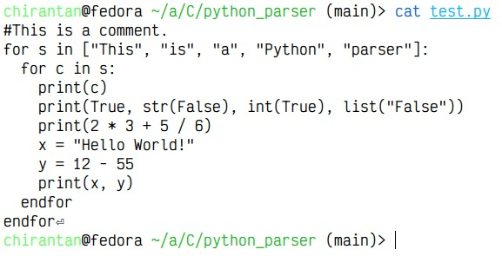
Sample Input

Slide 11
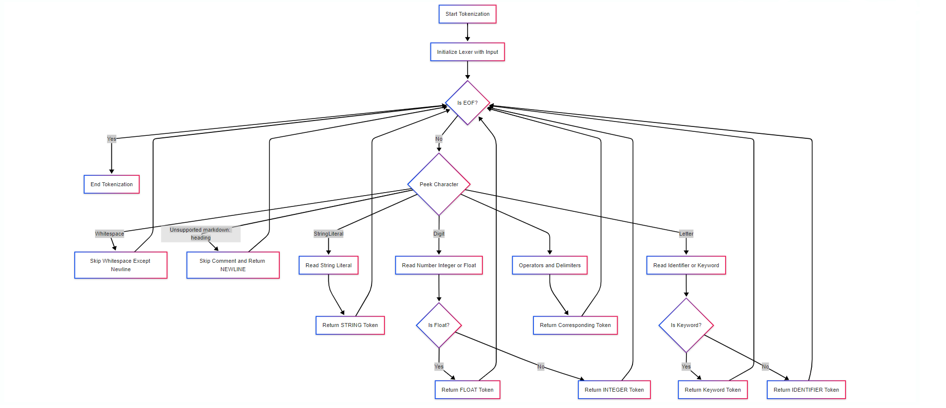
Lexer-Flow Diagram

Slide 12
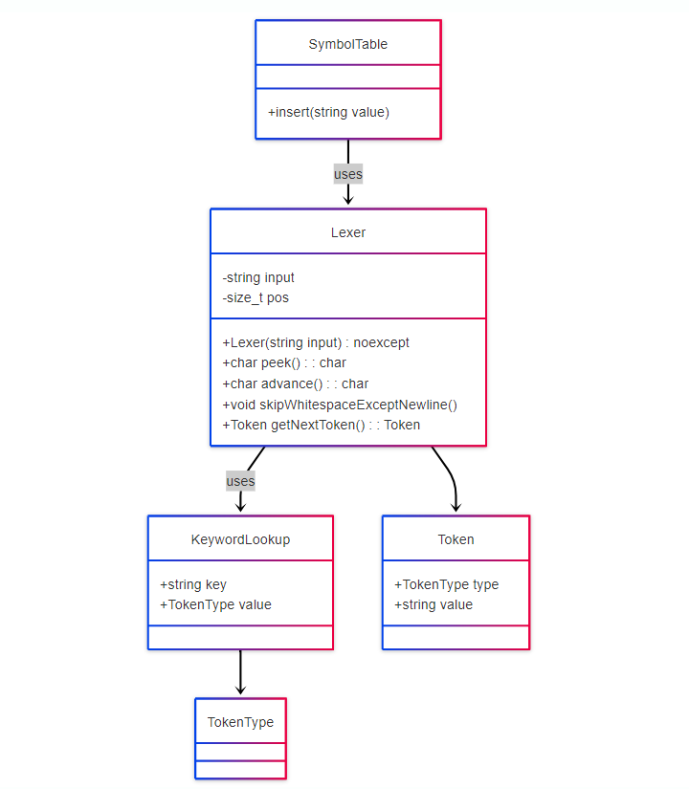
Lexer-Class Diagram

Slide 13
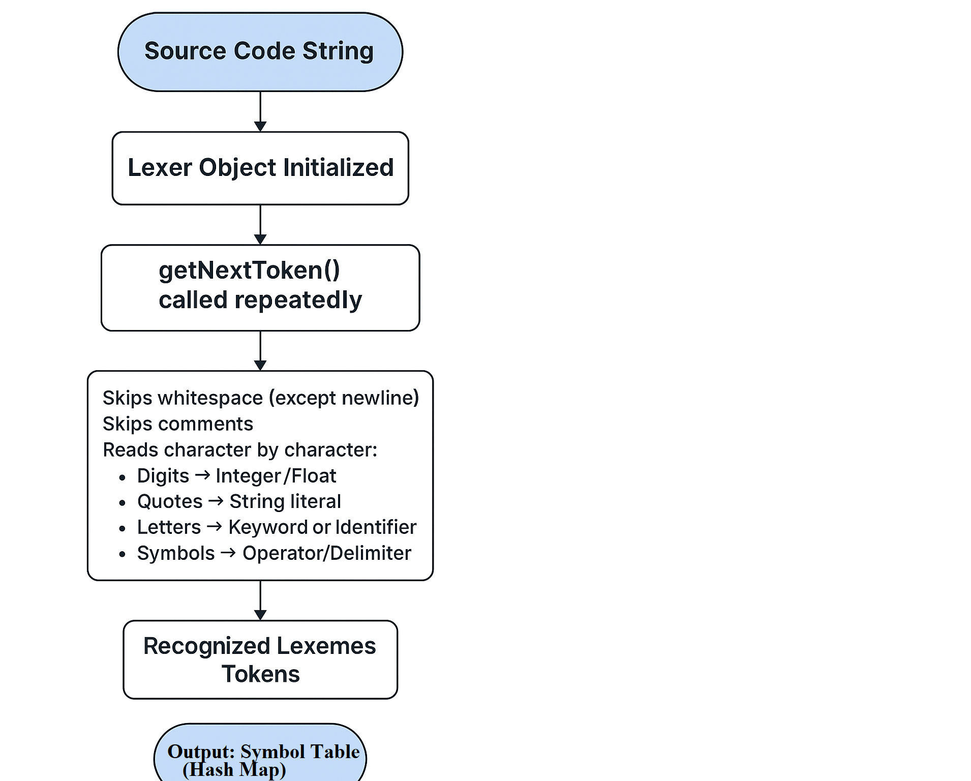
Lexer-Methodology

Slide 14
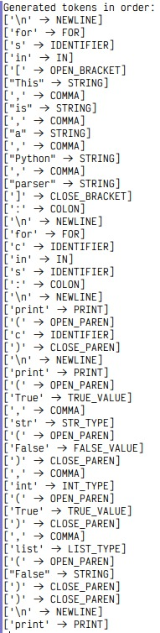
Lexer Output

Slide 15
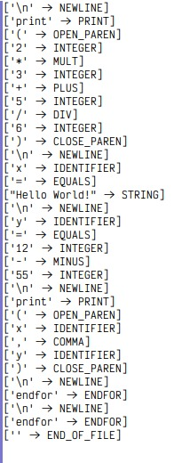
Lexer Output(contd)

Slide 16
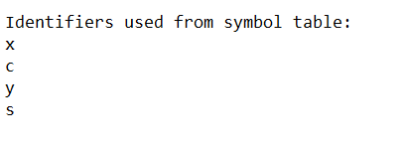
Lexer Output(contd)

Slide 17
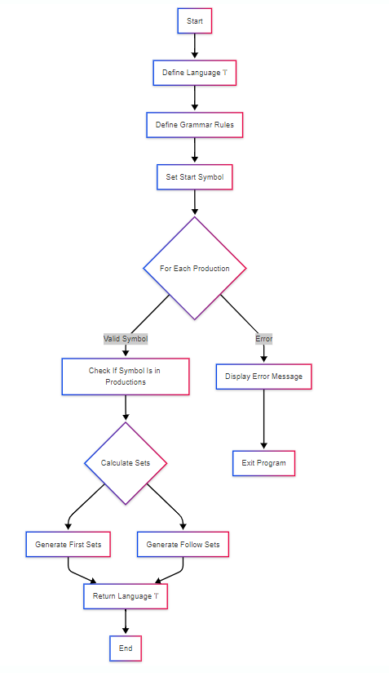
Parsing Flow Diagram

Slide 18
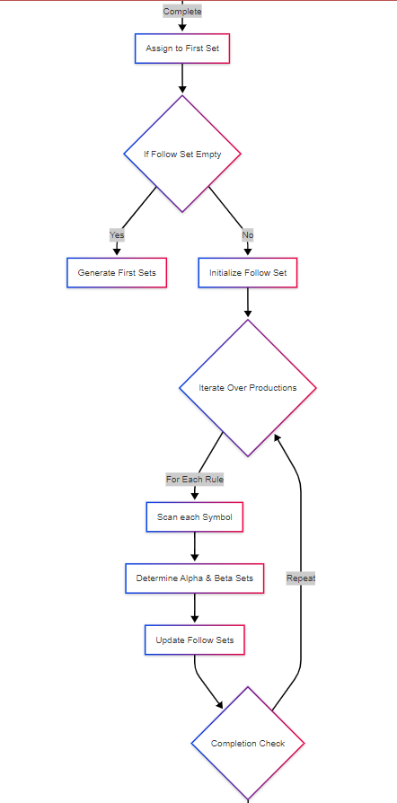
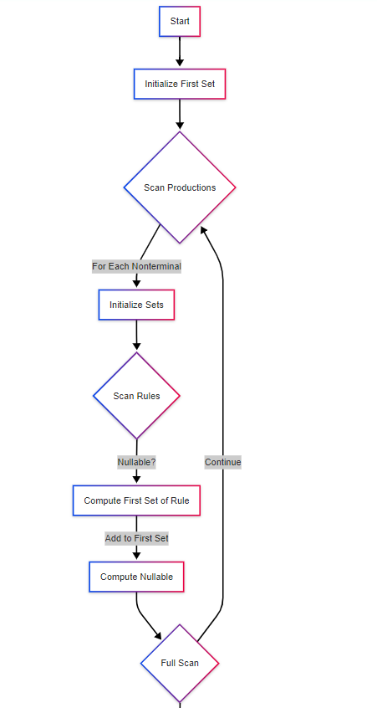
First-Follow Flow Diagram

Slide 19
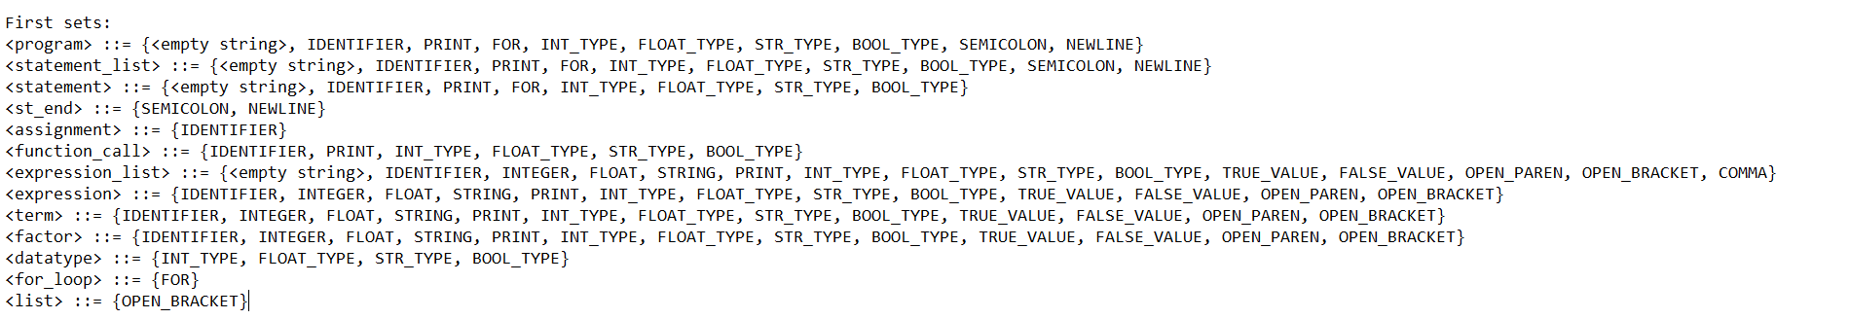
First Set

Slide 20
First Set-Methodology
Initialization:
Clear the first map.
Processing Each Non-terminal:
For each production rule of a non-terminal:
Traverse symbols left-to-right.
Add each symbol’s FIRST set to the current non-terminal’s FIRST set.
Stop if a symbol’s FIRST set does not contain EPSILON.

Slide 21
First Set-Methodology(contd)
Handling Nullable Productions:
If a rule can derive ε (empty string), add EPSILON to that non-terminal’s FIRST set.
Repeat until no new changes (fixed-point iteration).

Slide 22
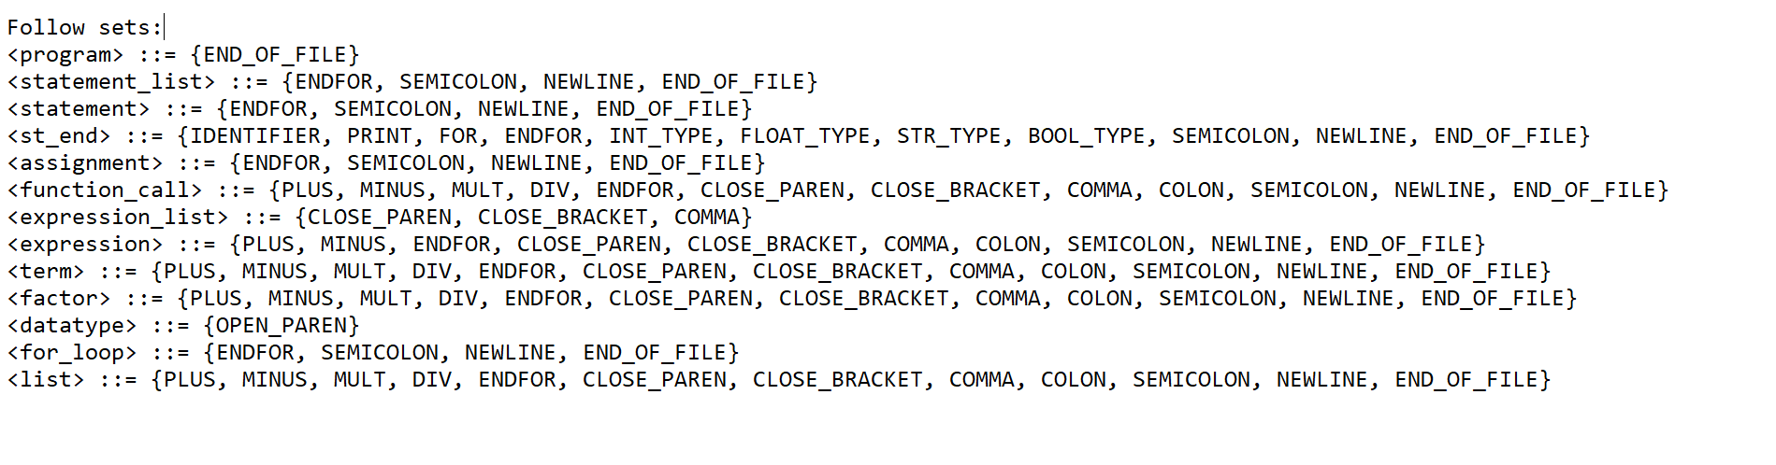
Follow Set

Slide 23
Follow Set-Methodology
Initialization:
Ensure first sets are computed.
Clear the follow map
Add END_OF_PROGRAM_INDICATOR to FOLLOW of the start symbol.

Slide 24
Follow Set-Methodology(contd)
Processing Rules:
For each non-terminal’s rules:
For each symbol in a rule:
If it’s a non-terminal, compute:
FIRST of the rest of the rule (β) after the symbol.
Add FIRST(β) \ {ε} to FOLLOW(symbol).
If ε ∈ FIRST(β), also add FOLLOW(non-terminal) to FOLLOW(symbol).
Fixed-Point Iteration:
Repeat until FOLLOW sets stop changing

Slide 25
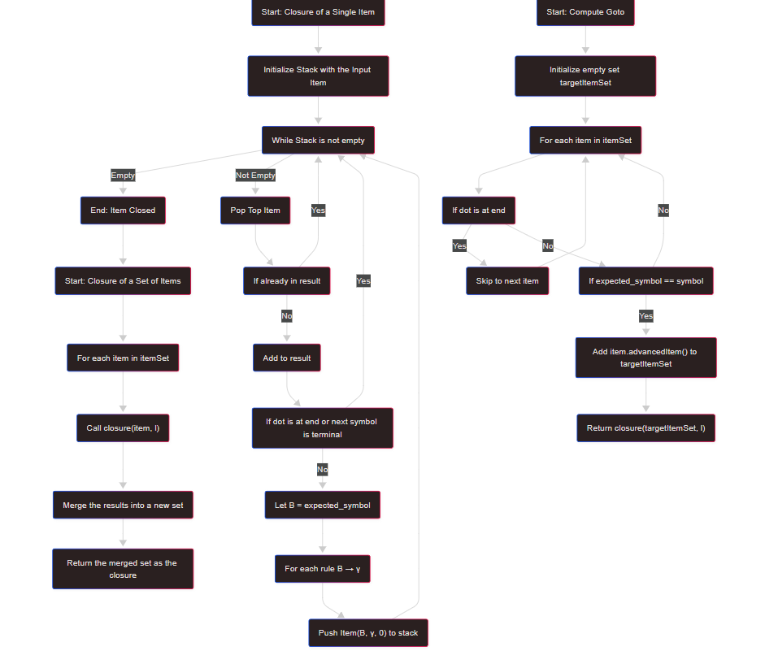
Item Set-Flow Diagram

Slide 26
Item Set-Methodology
Closure of a Single Item (closure(item, l))-Expand an item by recursively adding rules of expected non-terminals.
Stack with the input item
While stack is not empty:
Pop top item
If already in result, continue
Add to result
If dot is at end or next symbol is terminal, skip
Else:
Let B = expected_symbol (non-terminal after dot)
For each rule B → γ in l.prods[B], push Item(B, γ, 0) to stack

Slide 27
Item Set-Methodology
Closure of a Set of Items (closure(itemSet, l))-Expand a whole item set.
For each item in itemSet:
Call closure(item, l)
Merge the results into a new set
Return the merged set as the closure.
Compute Goto (computeGoto(itemSet, symbol, l))-Determine transition to a new item set when reading a symbol.
Initialize empty set targetItemSet
For each item in itemSet:
If dot is at end, skip
If expected_symbol == symbol:
Add item.advancedItem() to targetItemSet
Return closure(targetItemSet, l)

Slide 28
Item Set-Methodology
AdvancedItem
item.advancedItem() moves the dot one step to the right.
Example:
A → α . X β becomes A → α X . β

Slide 29
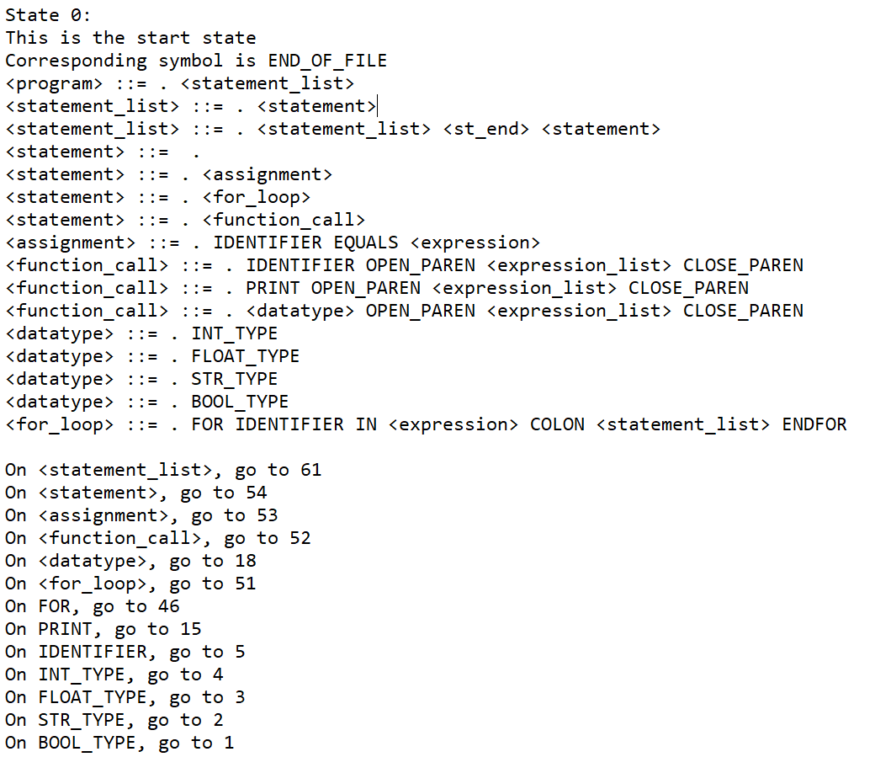
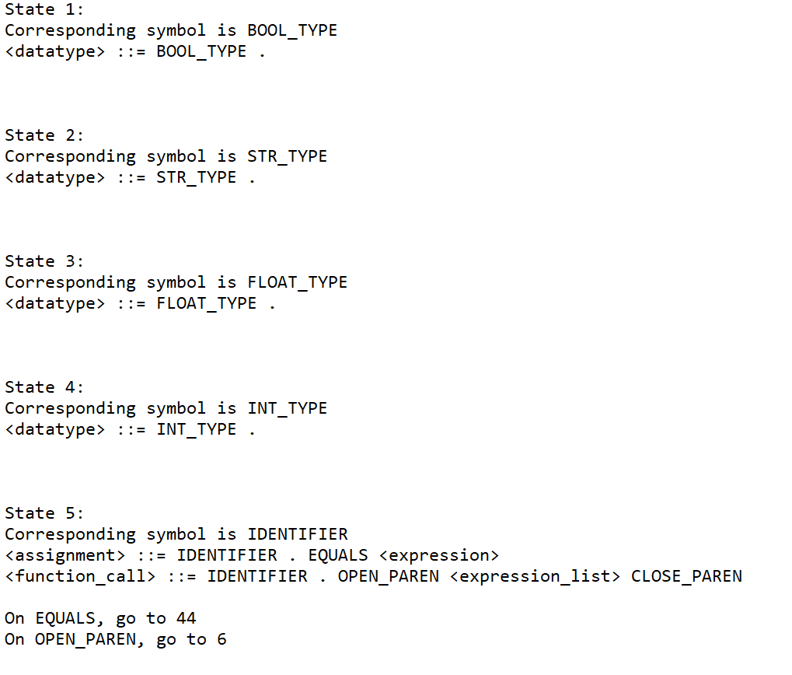
Item Set

Slide 30
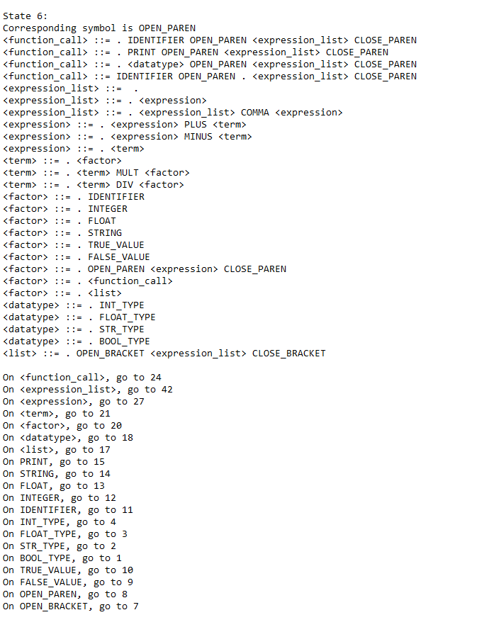
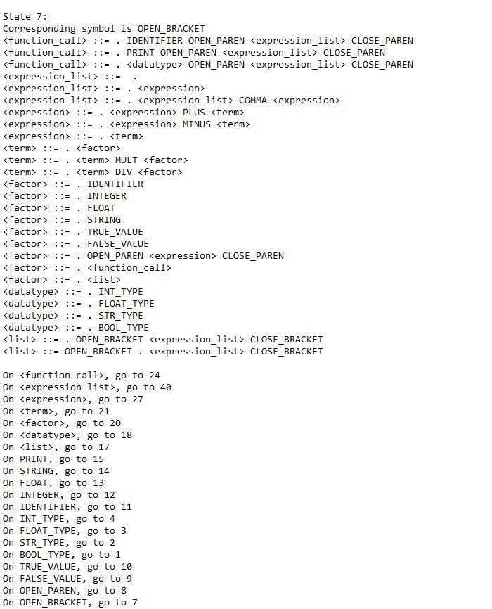
Item Set(contd)

Slide 31
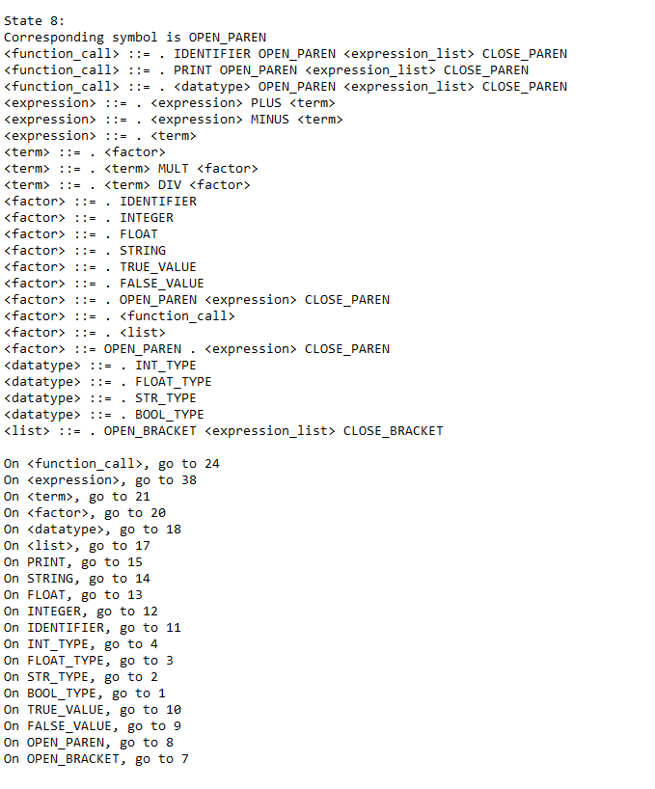
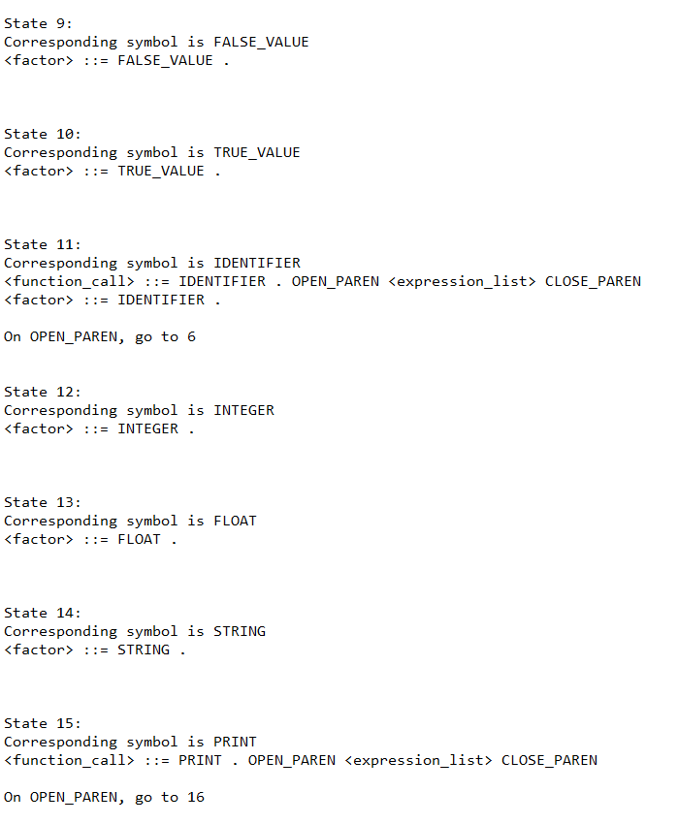
Item Set(contd)

Slide 32
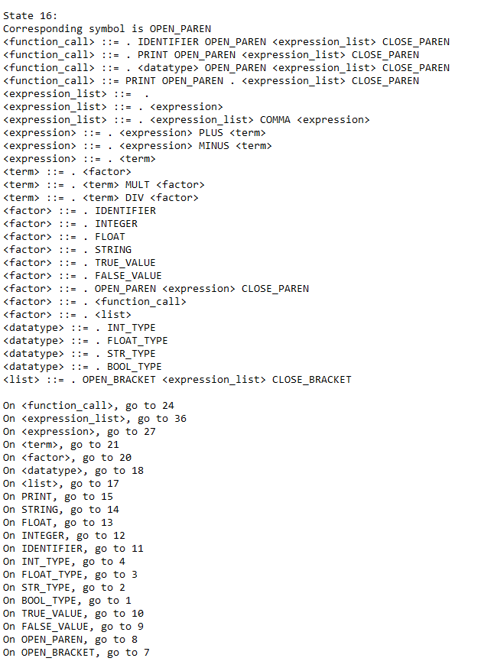
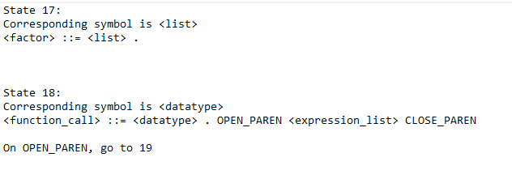
Item Set(contd)

Slide 33

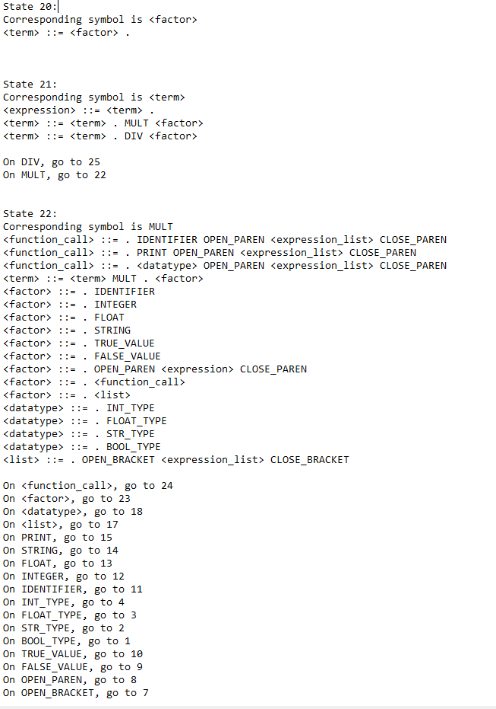
Item Set(contd)

Slide 34
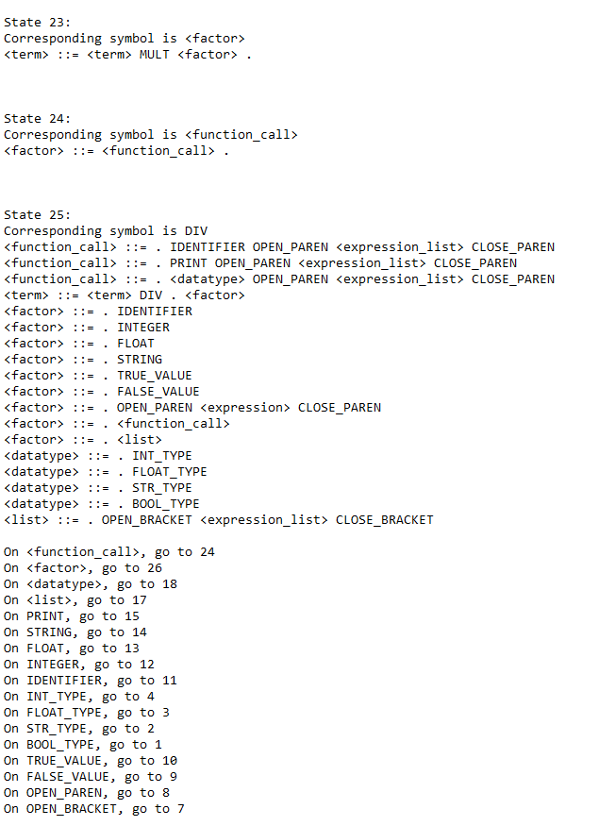
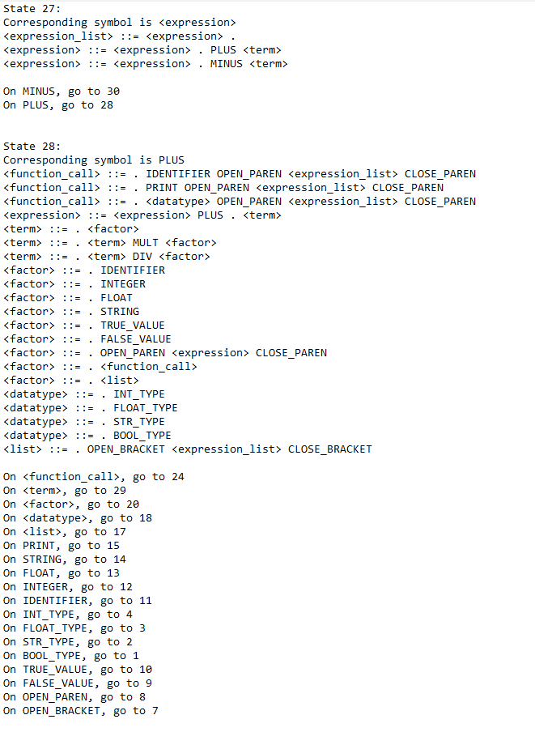
Item Set(contd)

Slide 35
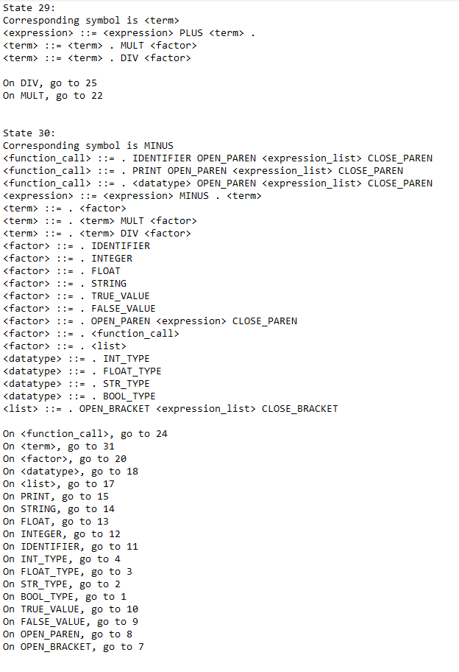
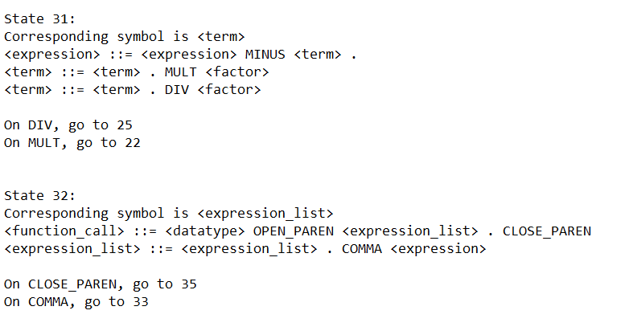
Item Set(contd)

Slide 36
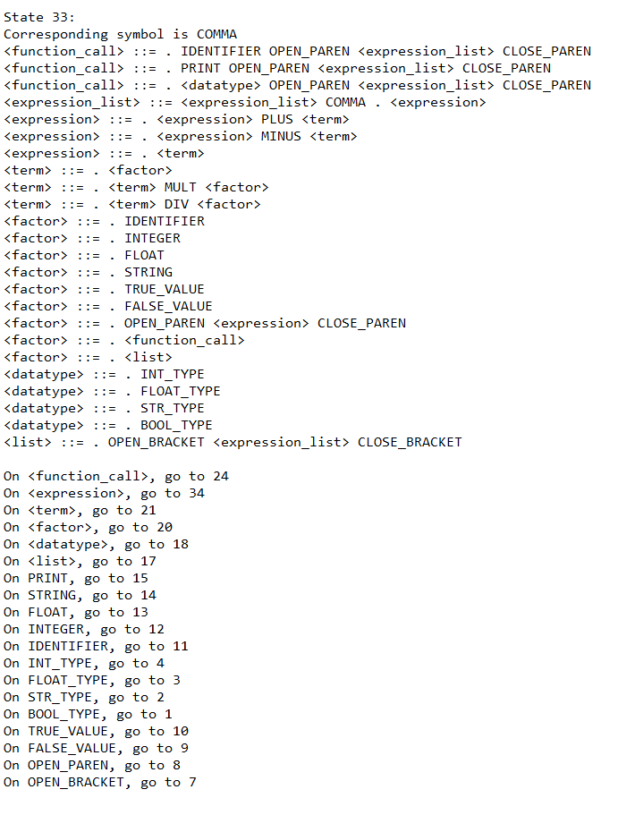
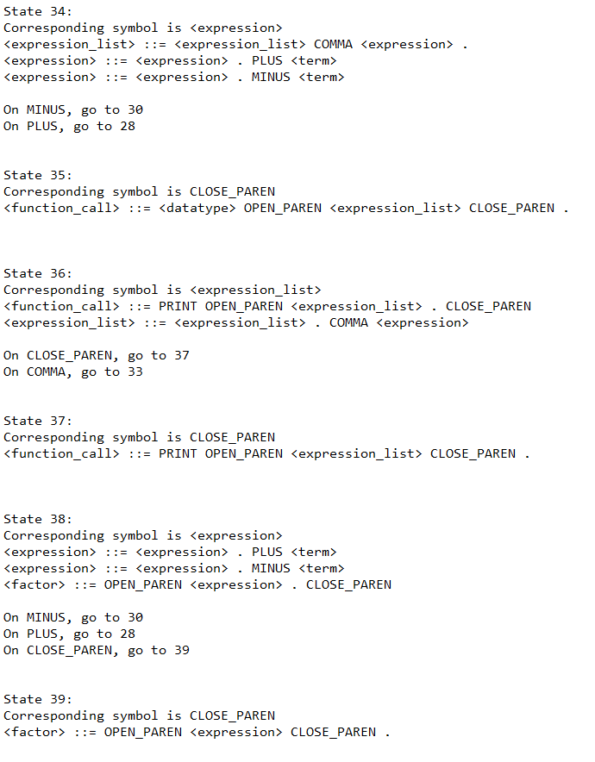
Item Set(contd)

Slide 37
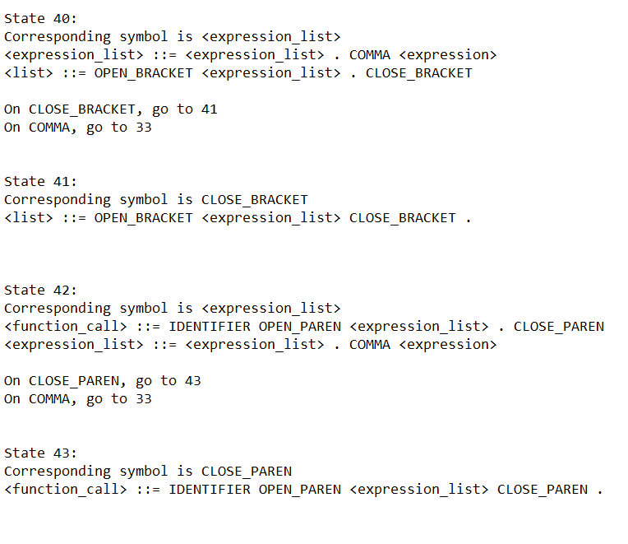
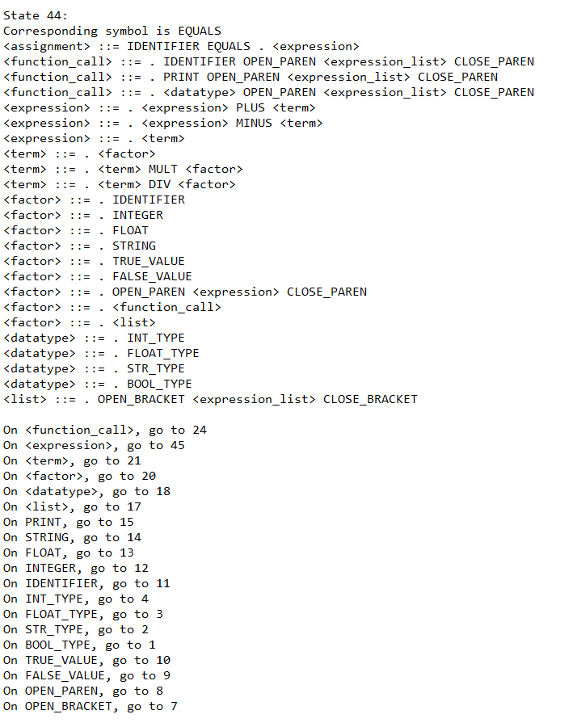
Item Set(contd)

Slide 38
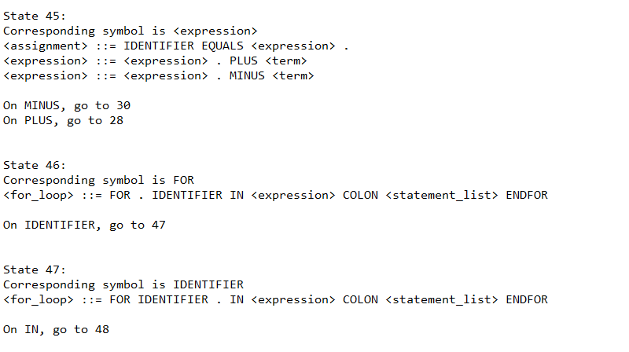
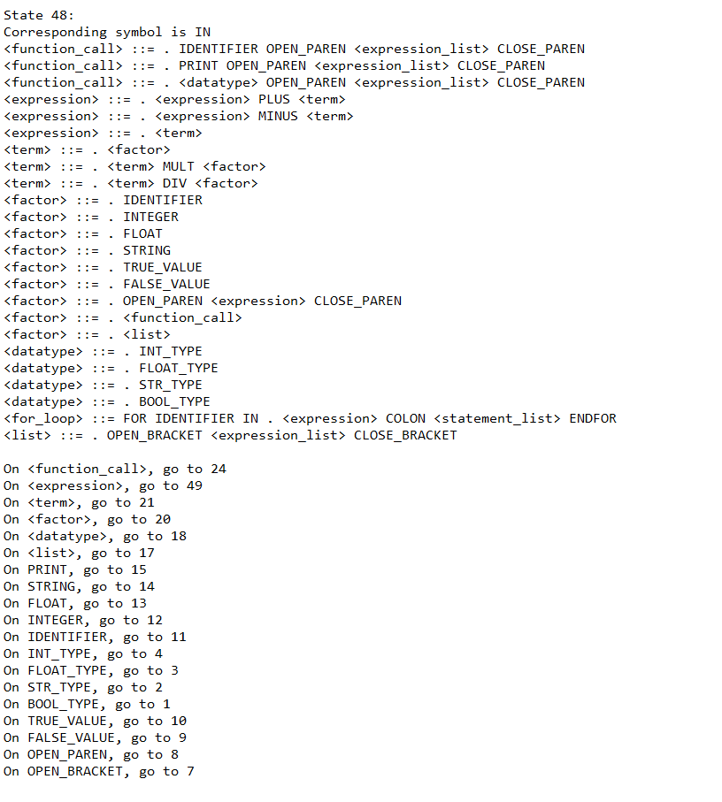
Item Set(contd)

Slide 39
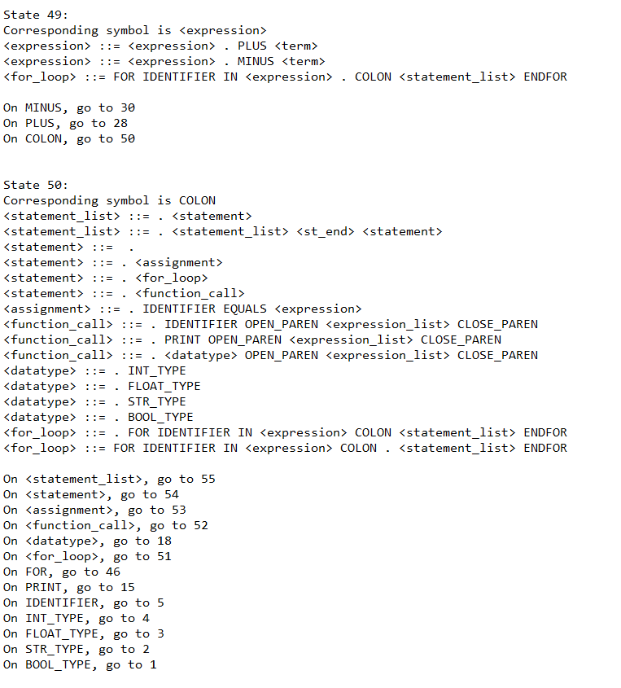
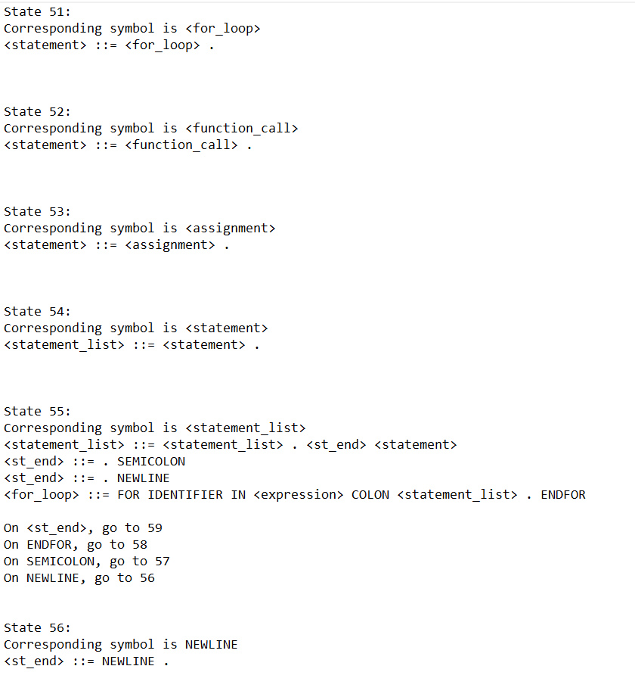
Item Set(contd)

Slide 40
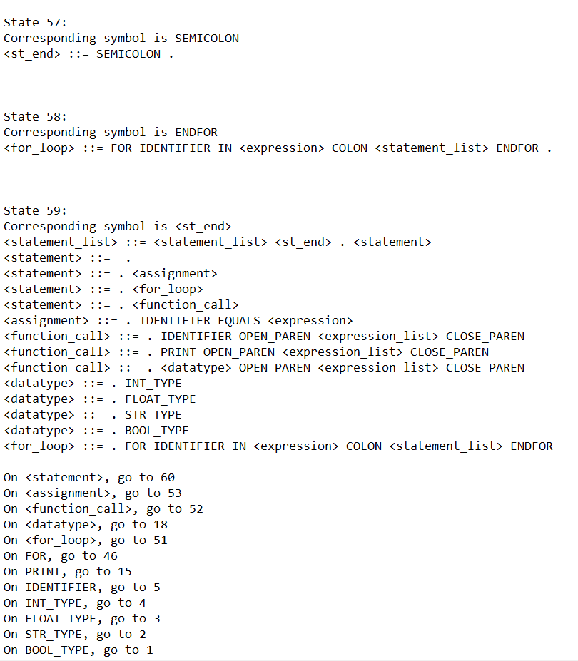
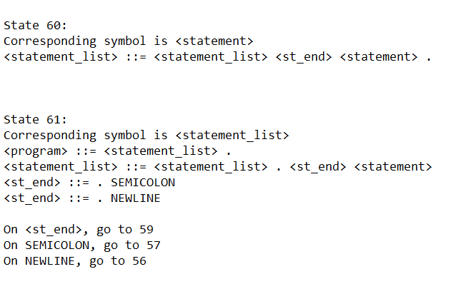
Item Set(contd)

Slide 41
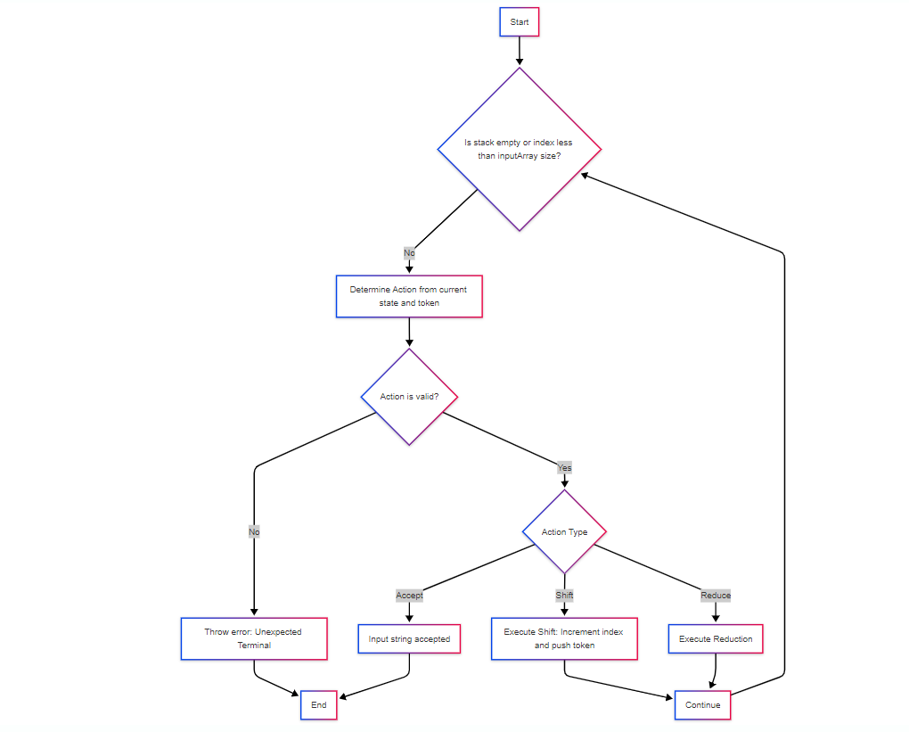
Parsing-Flow Diagram

Slide 42
Parsing-Methodology
Initialize Stack:
Start with the initial parsing state and an end-of-program marker.
Token Processing Loop:
Iteratively process tokens from the input stream (inputArray).
At each step, consult the parsingTable using the current state and lookahead token.

Slide 43
Parsing Methodology(contd)
Perform Actions:
Shift:
Push the current token and new state onto the stack.
Advance the input token index .
Reduce:
Apply a grammar rule (non-terminal → rule).
Pop stack elements equal to the length of the rule.
Push the corresponding non-terminal with the next state from the gotoTable.
Accept:
If the parser reaches an accept action, the input string is valid.

Slide 44
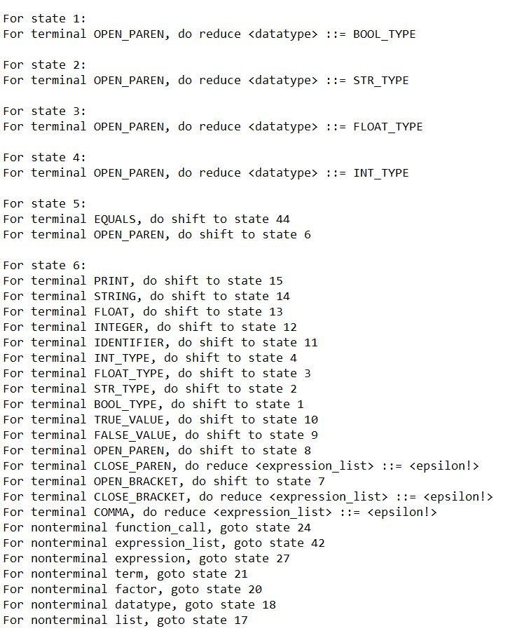
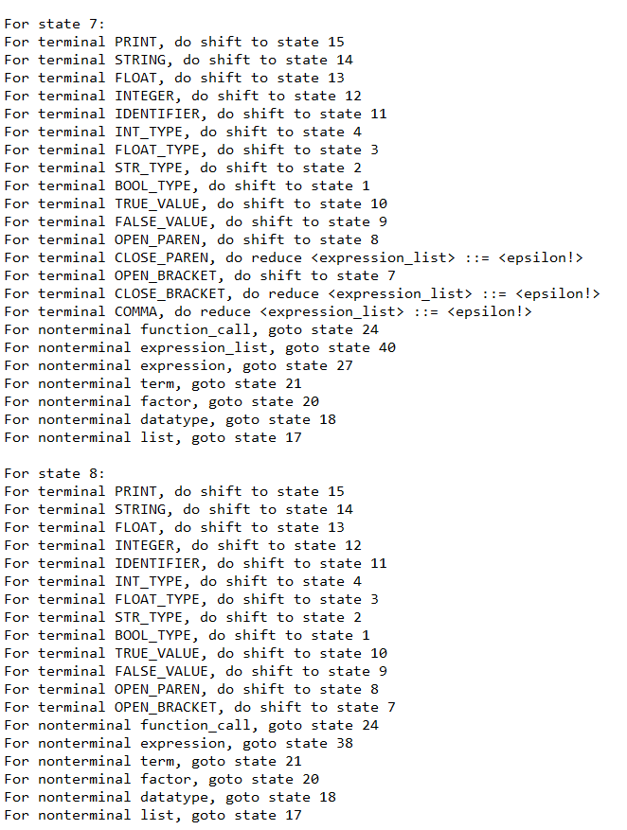
Parsing Table

Slide 45
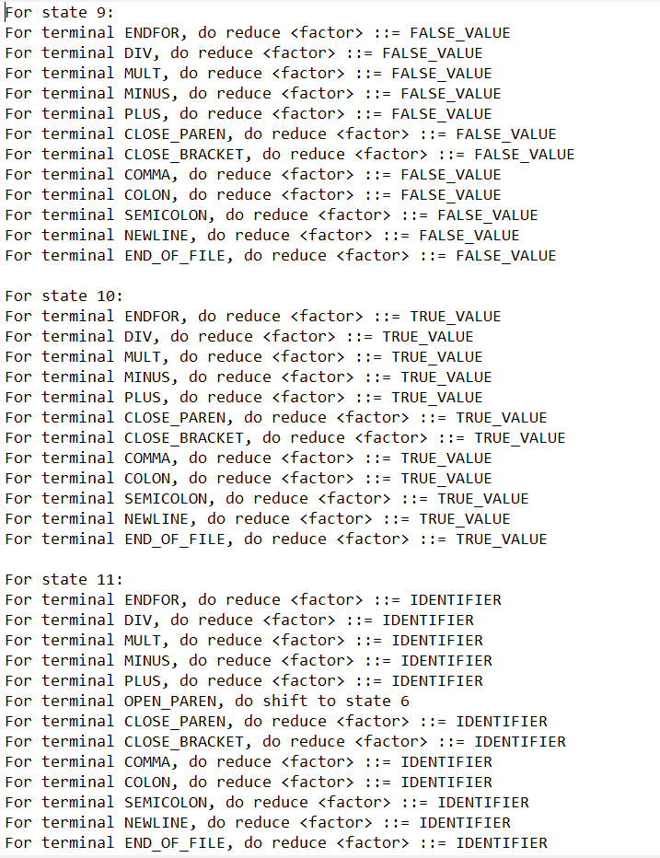
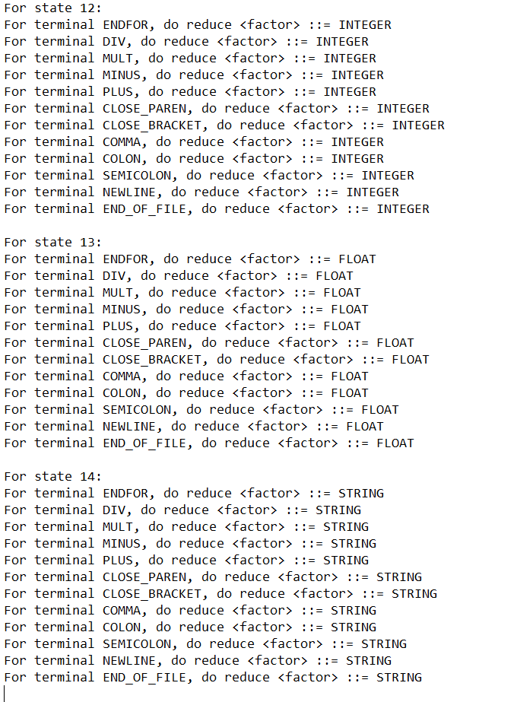
Parsing Table(contd)

Slide 46
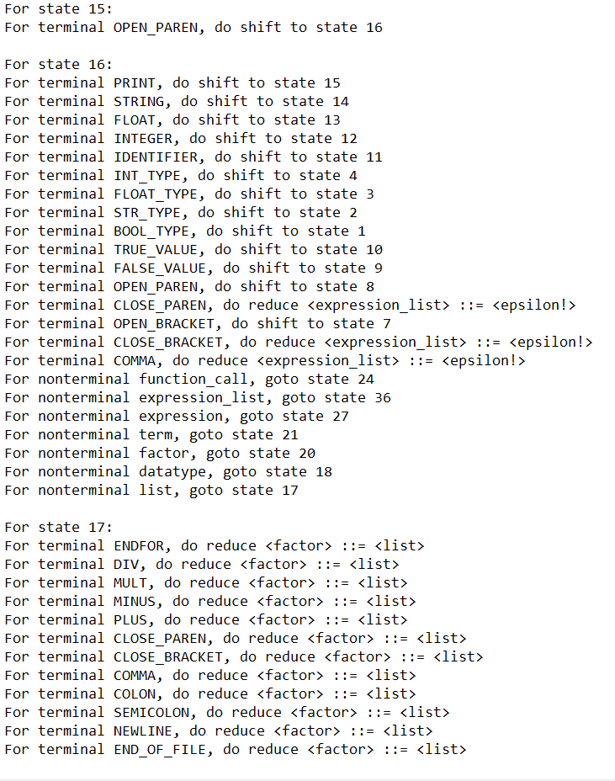
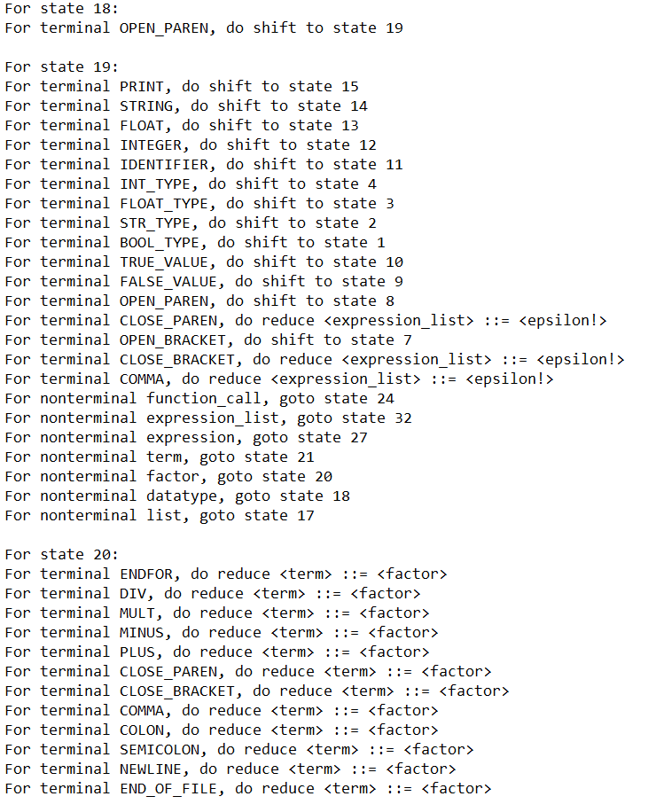
Parsing Table(contd)

Slide 47
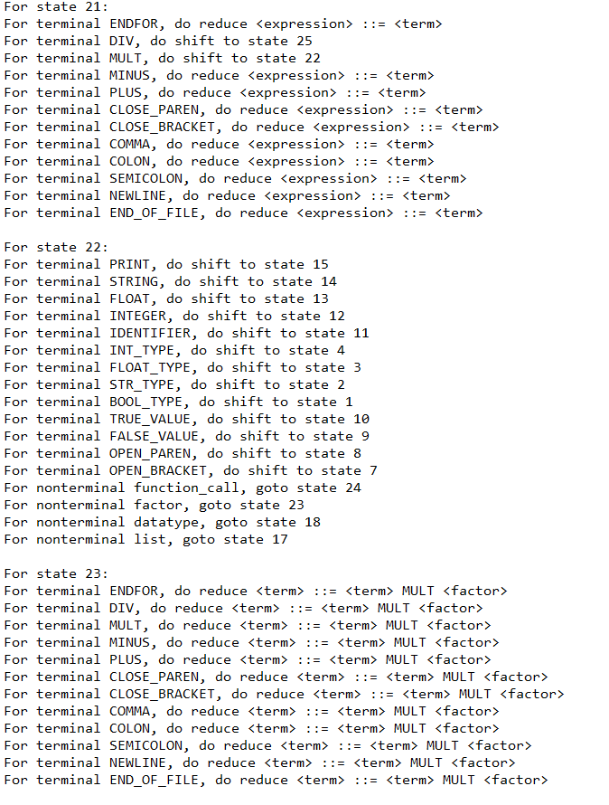
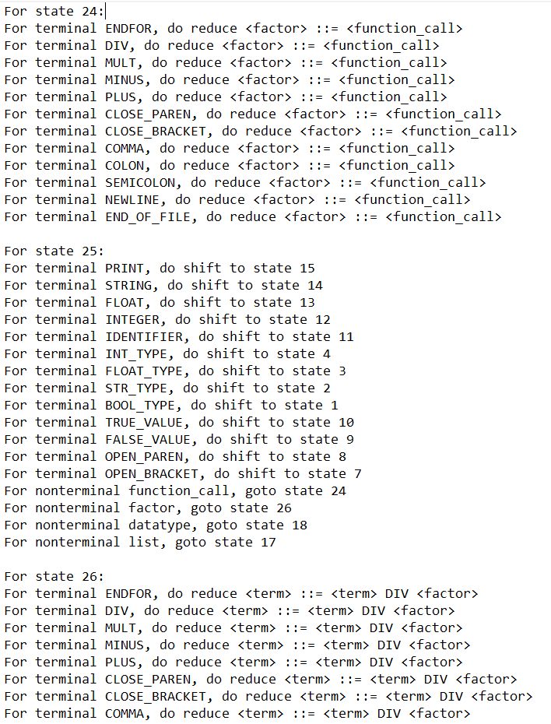
Parsing Table(contd)

Slide 48
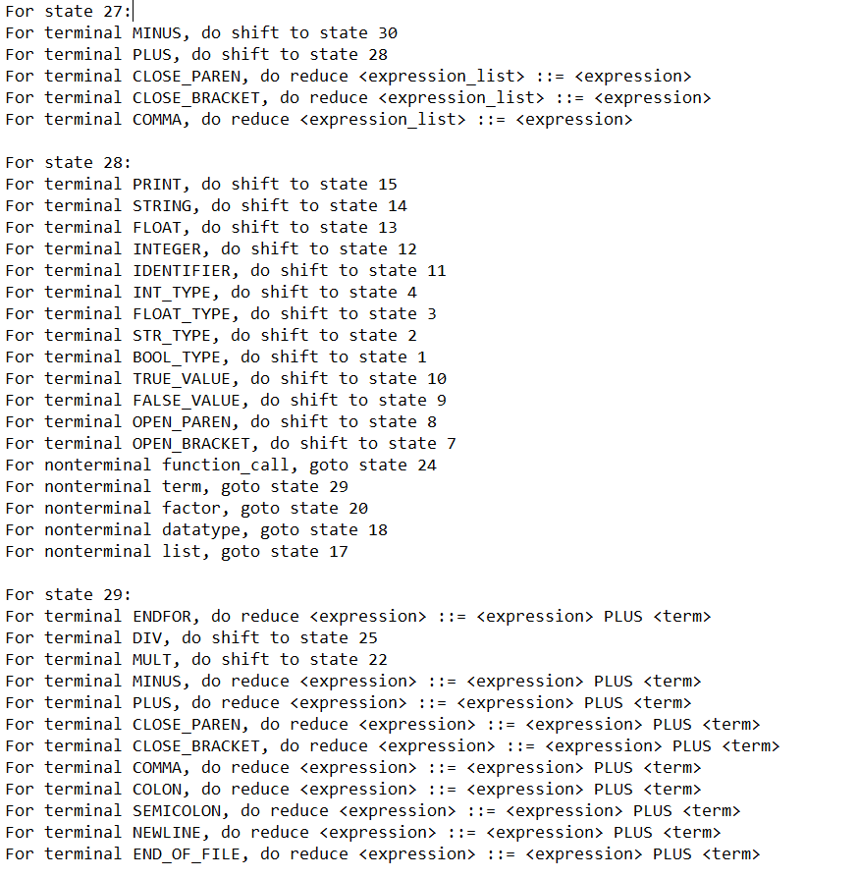
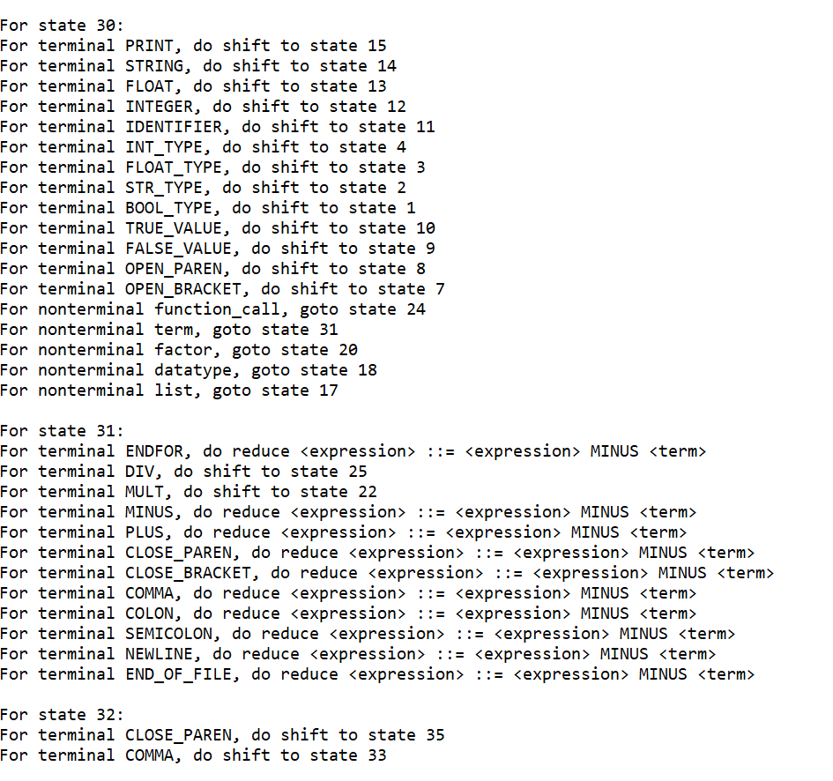
Parsing Table(contd)

Slide 49
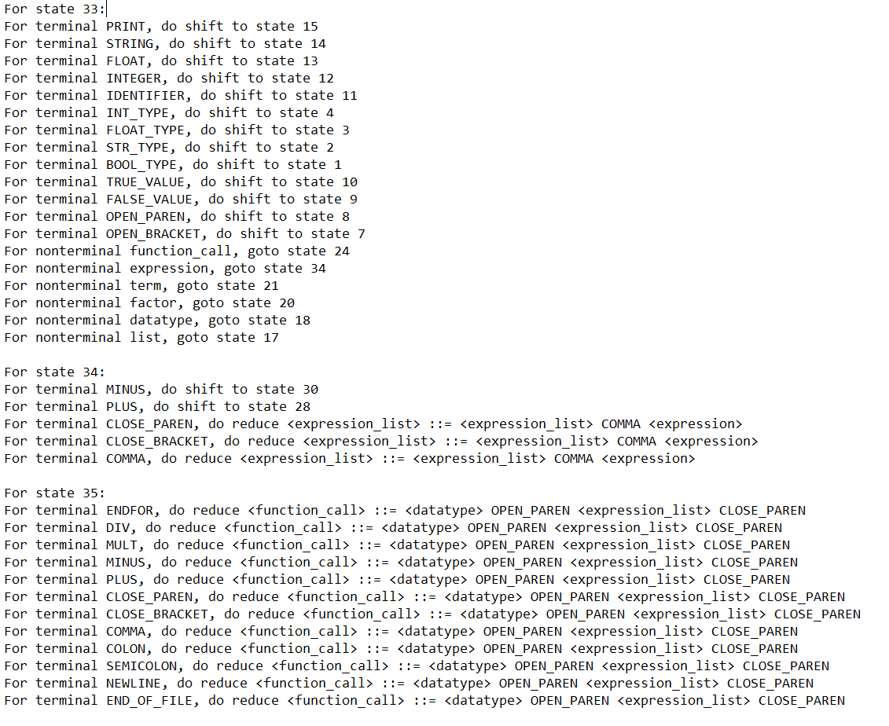

Parsing Table(contd)

Slide 50


Parsing Table(contd)

Slide 51


Parsing Table(contd)

Slide 52


Parsing Table(contd)

Slide 53
Table Generation-Methodology
Step 1: Build Transitions – buildTransitions()
Goal: Construct all unique LR(0) item sets (states) and transitions between them
Algorithm:
Initialize:
unmarkedStates ← ∅ (stack of unprocessed item sets)
startState ← closure of initial item
push startState into unmarkedStates

Slide 54
Table Generation-Methodology(contd)
While unmarkedStates is not empty:
Pop state from stack.
If state is already visited, skip.
Assign a unique index to the state.
For each non-terminal and terminal symbol
Compute targetState ← computeGoto(state, symbol)
If targetState is non-empty:
Push targetState into stack
Record transition[state][symbol] ← targetState
Track the symbol that led to this target state for conflict detection
Error Detection:
If multiple symbols lead to the same state → Conflict → Not LR(0)

Slide 55
Table Generation-Methodology(contd)
Step 2: Build Parsing Table – buildParsingTable()
Goal: Construct shift/reduce/accept actions for each state.
Algorithm:
For each state:
For each item in the state:
If item is at end of rule:
For each terminal in FOLLOW(nonterminal):
Add Reduce Action to parsing table
Detect and report reduce/reduce conflicts
If item corresponds to the start production:
Add Accept Action
Else if item expects a terminal:
Add Shift Action to parsing table using transition
Detect and report shift/reduce or shift/shift conflicts
Else item expects a non-terminal:
Add corresponding goto entry

Slide 56

Sample Output - print(“Hello World”)

Slide 57
Thank You

